Slide 1
Neal Alexander, Juan Fernando Arenas, Robin Castro, Esteban Garcia, Juan Sebastian Hurtado, Lyda Osorio, Carlos Andres Sarmiento
Notes:
You can use this slide when teaching and presenting at TGHN LAC events

Slide 2

Cronograma
Hoy salón 106G, mañana 108G.
Sesiones teórico-prácticas
Mañana, una lluvia de ideas sobre posibles propuestas para proyectos futuros.

Slide 3
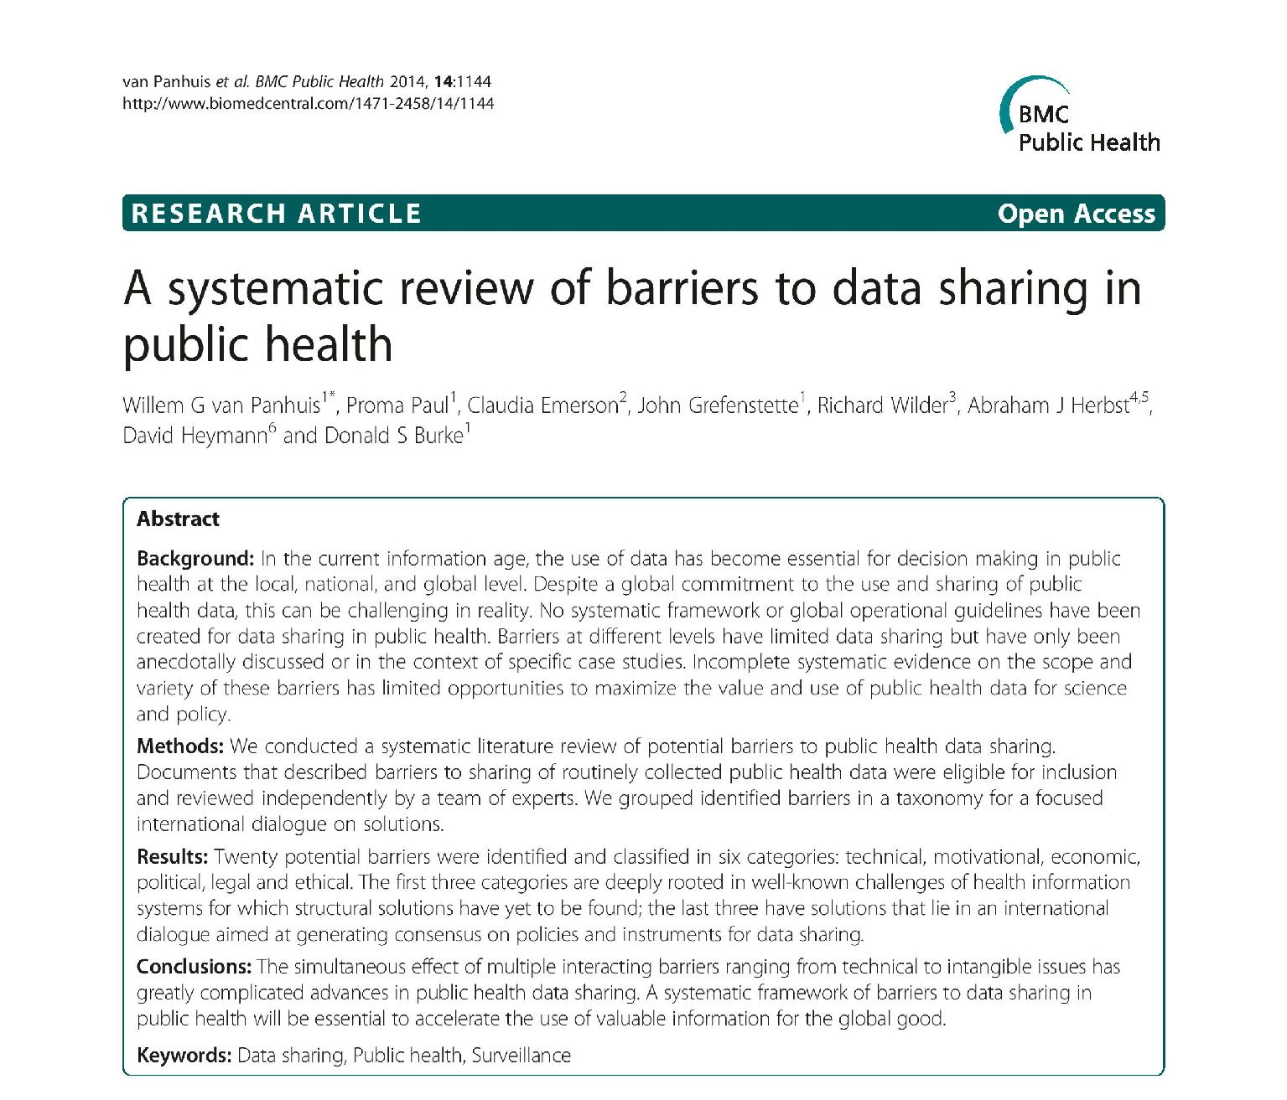

Slide 4
“Twenty potential barriers were identified and classified in six categories: technical, motivational, economic,
political, legal and ethical.”
Subset of PEARL: political, ethical, administrative, regulatory, and legal.

Slide 5
Origin of “Federated Learning”
McMahan et al 2016 “Communication-Efficient Learning of Deep Networks from Decentralized Data” arXiv
  First used by Google to improve next-word text prediction for Gboard.
Built on previous literature on, e.g. Privacy-Preserving Data Mining (PPDM), Secure Multi-Party Computation (SMPC) and Edge Computing.

Slide 6
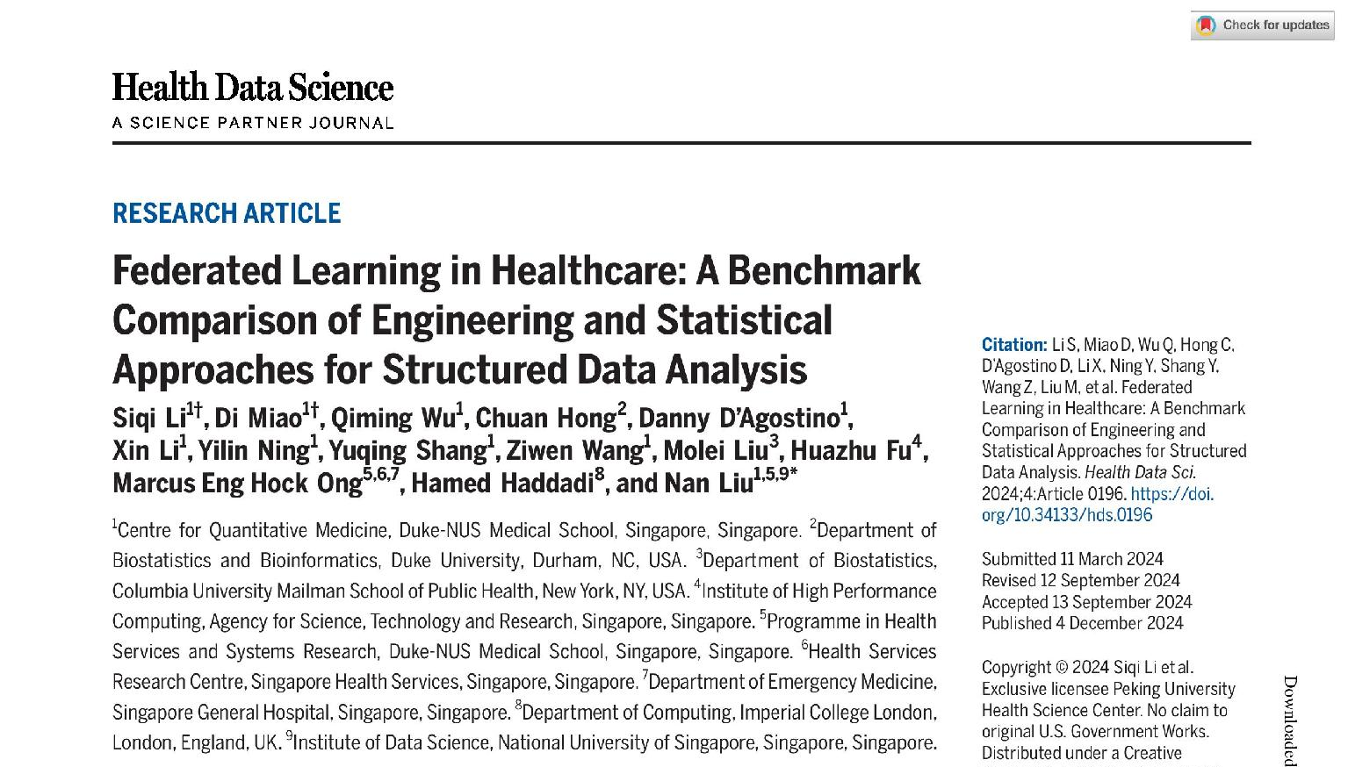

Slide 7
Engineering approaches, like the original FedAvg, focus on prediction, are model agnostic, and may be more prone to bias.
Statistical approaches, e.g. GLORE (Grid binary LOgistic REgression) focus more on parameter estimation from specific models, and may be less biased.

Slide 8
FL is not always exact
From site-specific statistics we can calculate overall median, standard deviation, minimum, etc, but not the overall median.
Lin (2013) explains this in terms of monoids: algebraic structures which have i) a set of elements, ii) an associative binary operation and iii) an identity element.
  For the mean, the elements are the site-specific means and counts; for SD, the counts, sums, and sum of squares.
But the median cannot be “monoidified”.

Slide 9
We have two participant profiles: clinician / epidemiologist and statistician / data scientist.
This is because we want the activity to have a public health impact, as well as imparting technical knowledge.

